Slide 1

Web Server Programming
Mid-Term
Student: Shukirillaev Mukhammadsodik ID:202438379

Slide 2
Question 1:
What are the main components of a RESTful architecture? Explain the
principles of REST

Slide 3
Answer
An architectural style for designing networked APIs, not a strict standard. APIs that follow it are "RESTful.
1. Client-Server: Separation of concerns. Client handles UI, server handles data/logic. They evolve independently.
2. Stateless: Every request must contain all info needed to process it. No client session stored on the server.
3. Cacheable: Server responses must say if they can be cached. Improves performance and scalability.
4. Uniform Interface (The Key Principle):
- Resources in URIs: Everything is a resource (e.g., /users/123).
- HTTP Verbs: Use GET (read), POST (create), PUT (update), DELETE.
- Self-Descriptive Messages: Use HTTP status codes (200 OK, 404 Not Found) and headers.
- Responses include links to related actions (e.g., “next_page” URL).
5. Layered System: Architecture can have layers (like load balancers, security). Client doesn't need to know.

Slide 4
Question 2:
Explain the concept of statelessness in HTTP and why it is important in web applications

Slide 5
Answer
Each HTTP request is independent and self-contained. Server doesn't remember anything between requests. Every request must include all necessary information (auth, data, etc.), which are authentication and data management
1. Scalability:
- Easy to add more servers
- Any server can handle any request
2. Reliability:
- No single point of failure
- If one server crashes, others can continue
3. Simplicity:
- Servers don't manage session storage
- Clean, predictable architecture
(Example) handling “state” (like login):
- Tokens (JWT) in headers
- Cookies with session IDs
- Client-side storage

Slide 6
Question 3:
Write a Spring Boot controller that accepts a POST request at /register with a JSON body containing name and email, and returns a confirmation message.
https://github.com/McLight-Note/Web-Server-Programming/tree/main/Mid-term

Slide 7
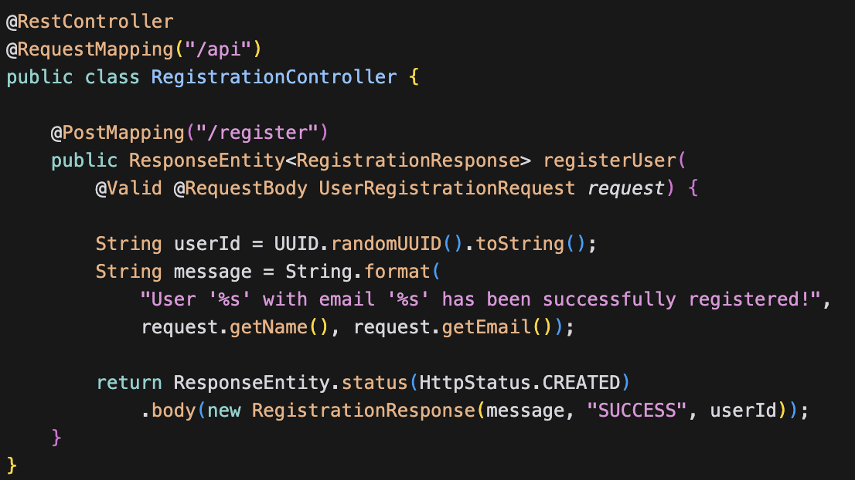
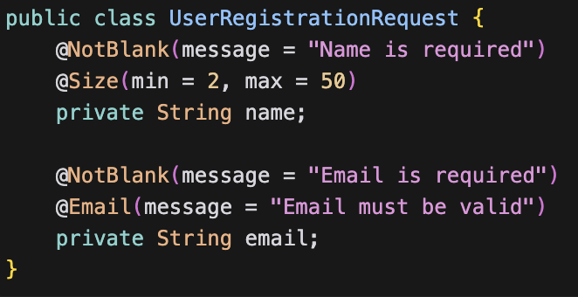
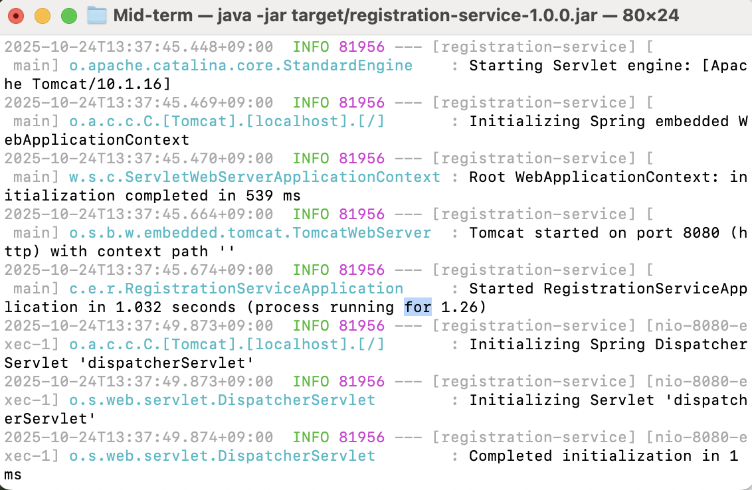
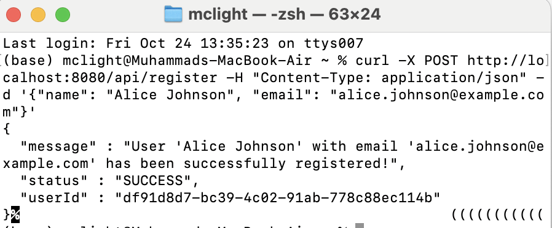
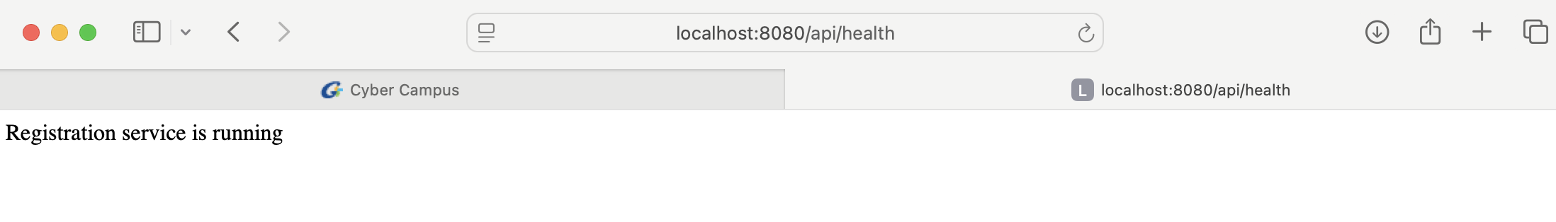
Code
Main controller code:
Request DTO (Input validation)
Here are all the codes for this application: https://github.com/McLight-Note/Web-Server-Programming/tree/main/Mid-term

Slide 8
Question 4:
Create a simple HTML form to register a new user (fields: name, email) that sends the data to /register using fetch () and JSON.
https://github.com/McLight-Note/Web-Server-Programming/blob/main/Mid-term/Task-2.html

Slide 9
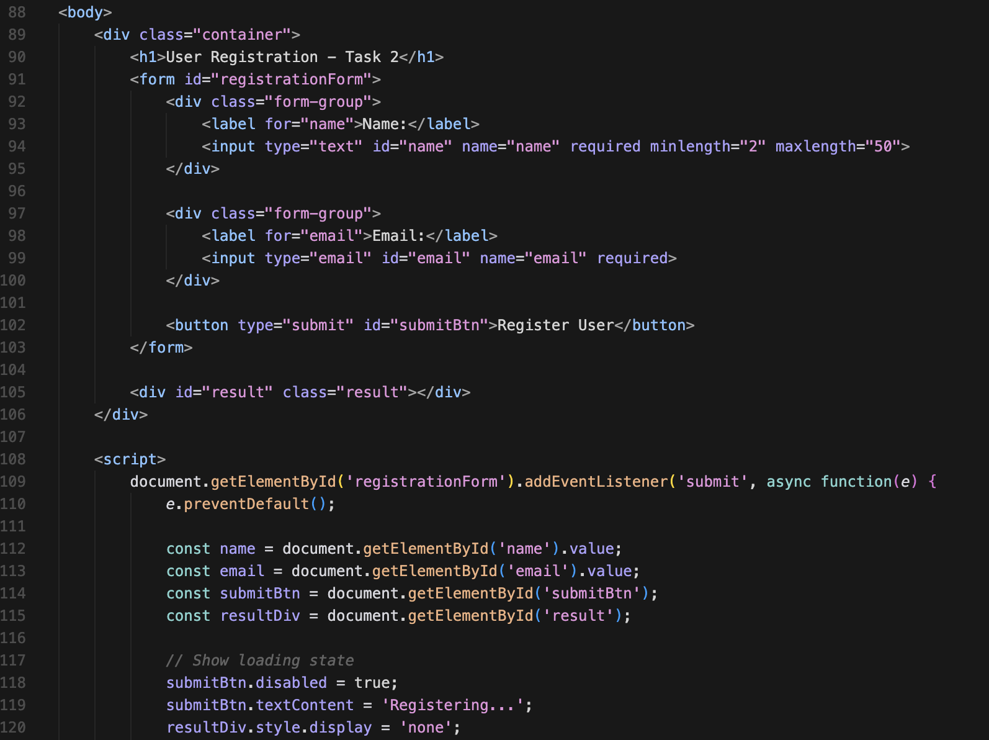
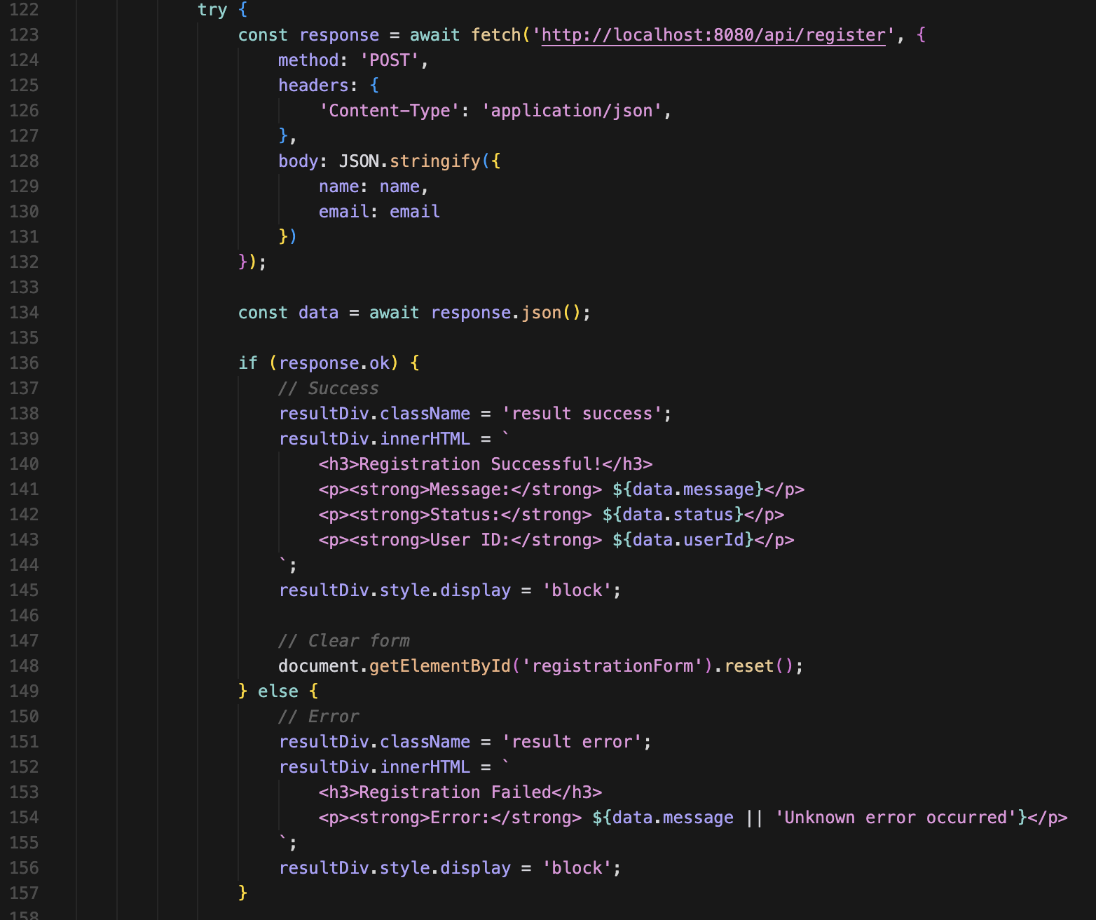
Code samples: Please Check the git.rep as well
Here are all the codes for this application: https://github.com/McLight-Note/Web-Server-Programming/blob/main/Mid-term/Task-2.html

Slide 10
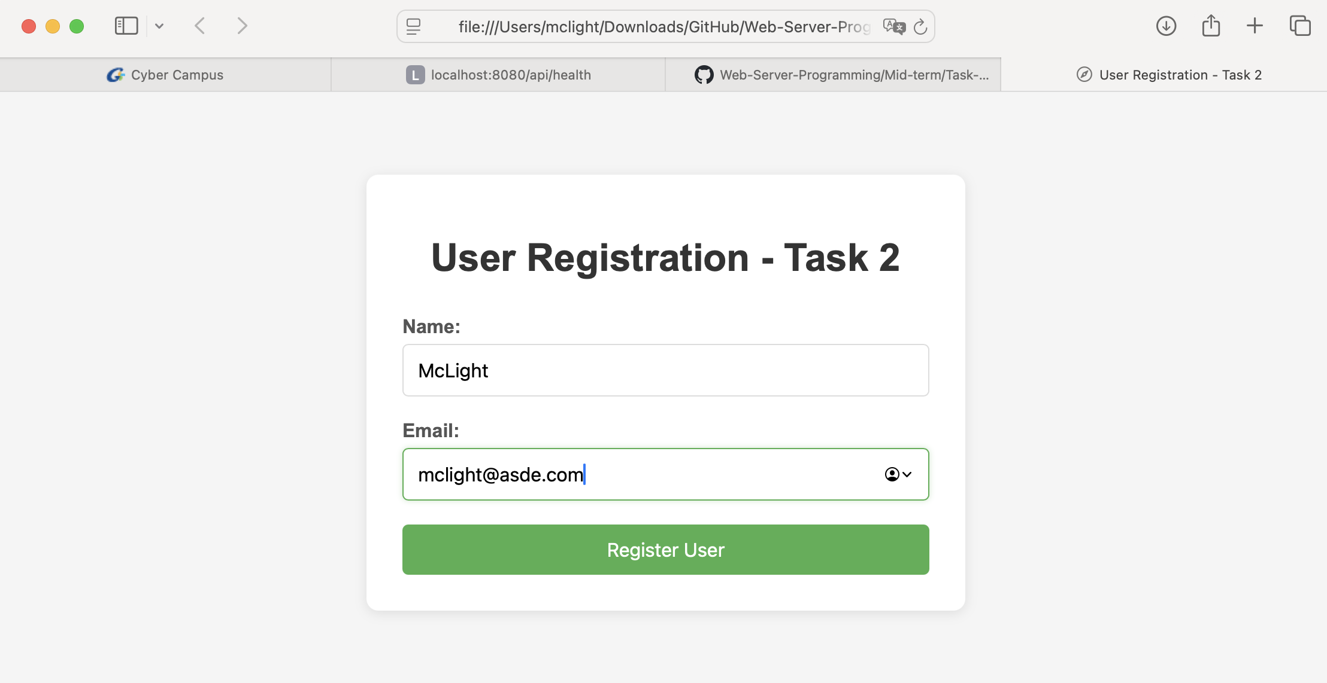
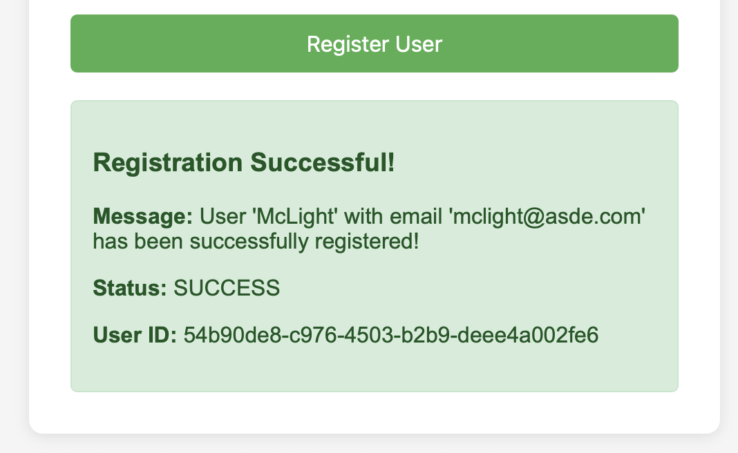
Result:
Here are all the codes for this application: https://github.com/McLight-Note/Web-Server-Programming/blob/main/Mid-term/Task-2.html

Slide 11
Question 5:
Implement server-side validation: return error message if email is missing or invalid.
https://github.com/McLight-Note/Web-Server-Programming/blob/main/Mid-term/Task-3.html

Slide 12
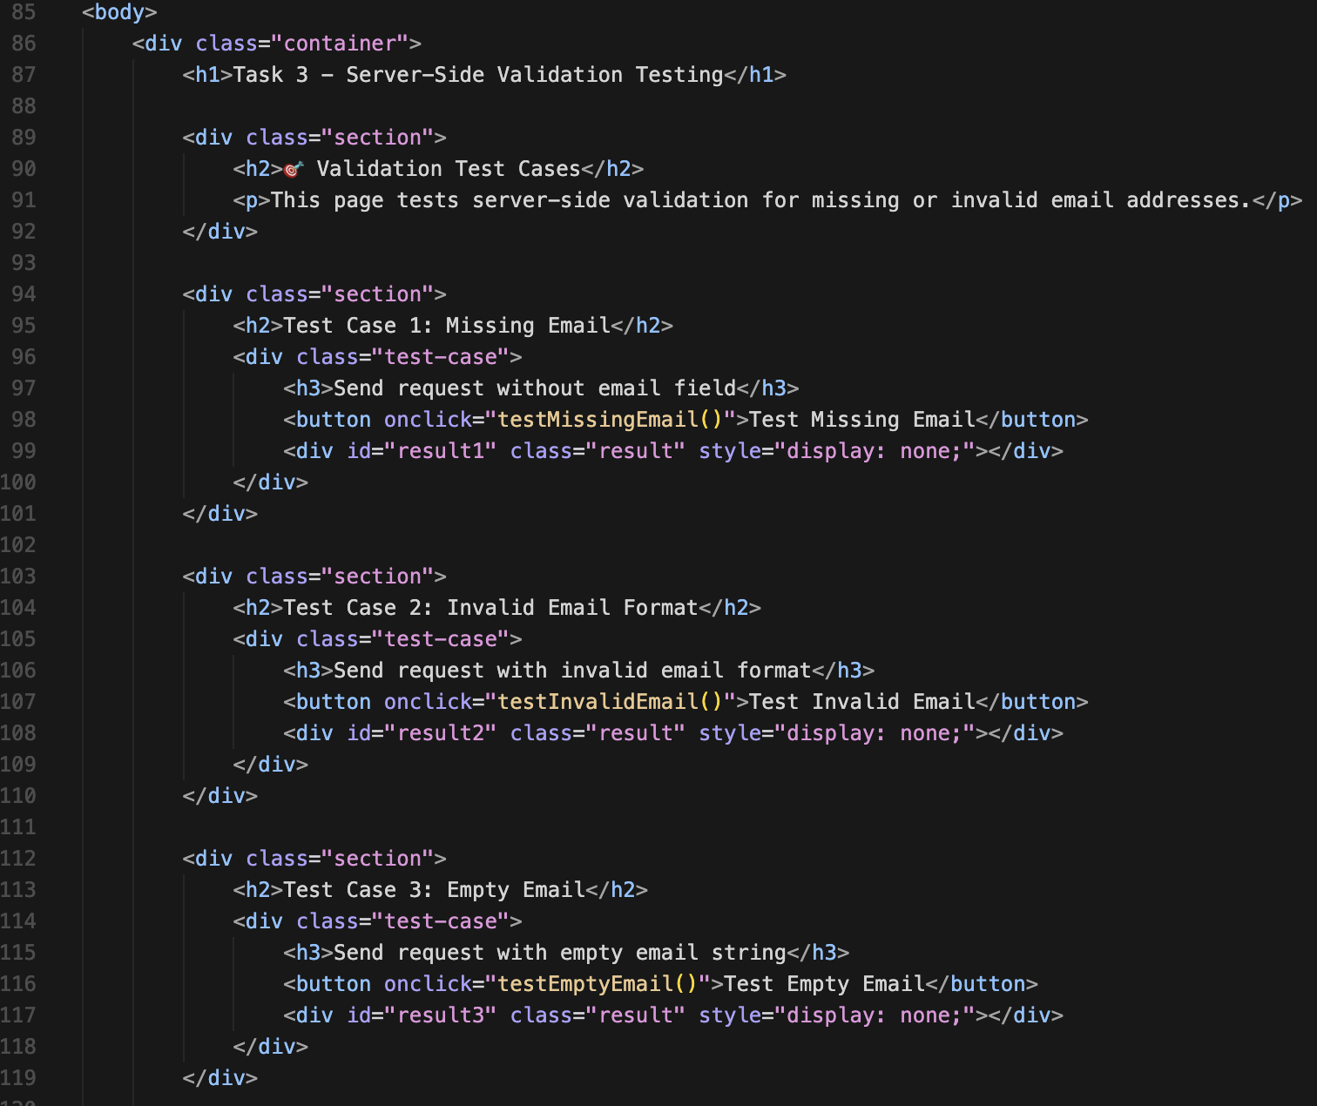
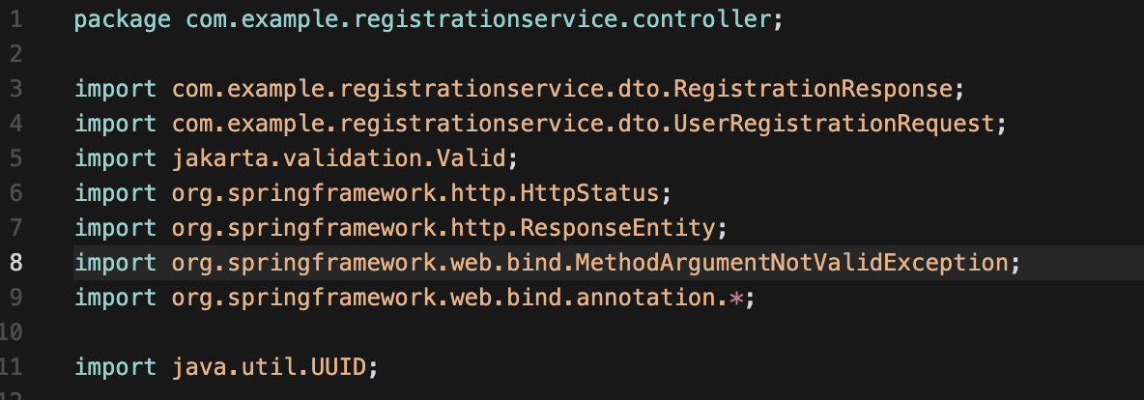
Code samples:
we have to import: org.springframework.web.bind.MethodArgumentNotValidException this one as well in order to handle the not valid arguments!
Here are all the codes for this application: https://github.com/McLight-Note/Web-Server-Programming/blob/main/Mid-term/Task-3.html

Slide 13
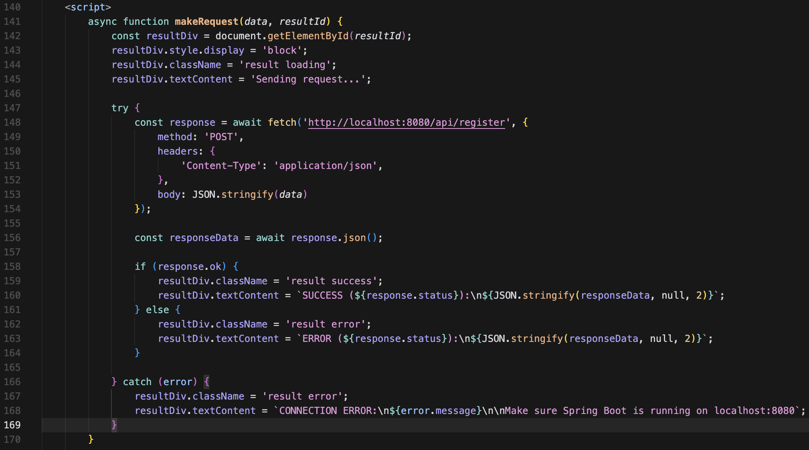
Code samples:
Here are all the codes for this application: https://github.com/McLight-Note/Web-Server-Programming/blob/main/Mid-term/Task-3.html

Slide 14
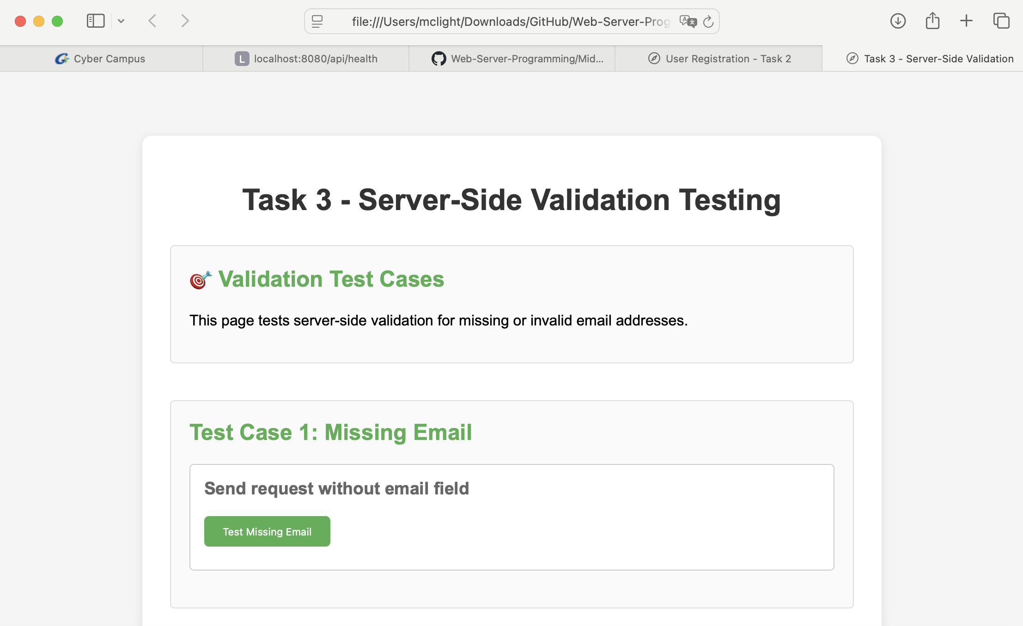
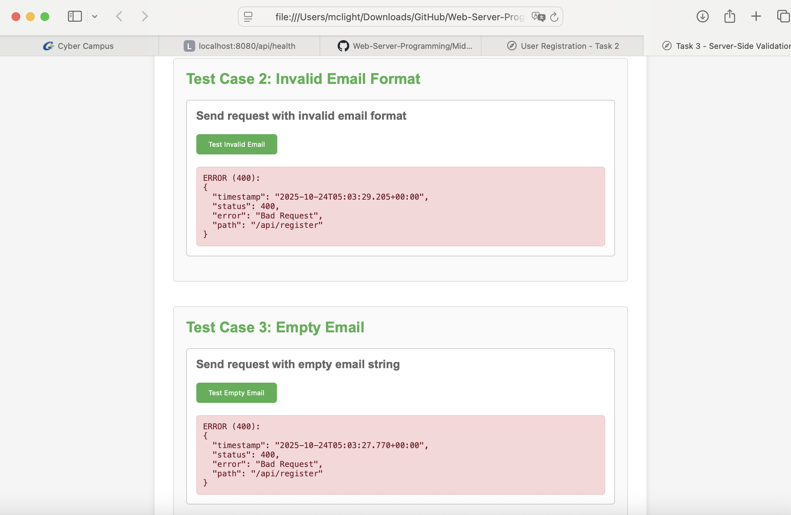
Result:
Here are all the codes for this application: https://github.com/McLight-Note/Web-Server-Programming/blob/main/Mid-term/Task-3.html

Slide 15
THANK YOU!

